Slide 1
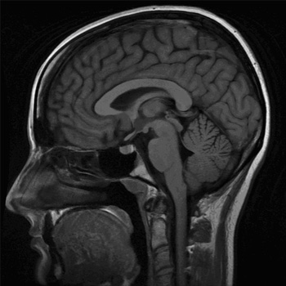
AUTISM
Plan:
I : History & Autism
II : Diagnosis & Classification
III : Treatments & Management
Page 1

Slide 2
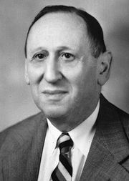
I : Hystory and autism
Main date
- 1911: word «autism » is created by E.Bleurer
- 1943: first studies by L.Kanner
- 1944: Asperger's works
- 1990: Classification of autism
Page 2

Slide 3

II : Diagnosis & Classification
Symptoms:
- Behavior problems
- Communications problems
- Lack of social relations
Classification:
- Infantil autism
- Rett's syndrome
- Asperger's syndrome
Page 3

Slide 4

III : Treatments & management
Treatments
- any curative treatment exist
The better solution to help autism is EDUCATION
Integration of autism in society
- Depend of type of autism
Page 4

